Slide 1
Proposition F Changes – 2021-2022

Slide 2
Prop F - High Level Changes (Effective 2021)
Eliminated Payroll Expense Tax (filed in 2022 for year 2021)
Increase Small Business Exemption to $2mm
Annual Business Registration Fee Increases (GR between $1.2mm- $2mm)
Annual Business Registration Fee Decrease (GR below $1.2mm)
Modified Gross Receipts Tax Rates
Modified Administrative Office Tax Rate (effective 2022)
Revision of Quarterly Payments of Gross Receipts and Admin Office Taxes
Elimination of Credit for Taxpayers who paid Gross Receipts in Other Jurisdictions
Homeless Gross Receipt Taxes are still in effect (disregard Prop F proposal)

Slide 3
Small Business Exemption
Main Change – Expanded SMB Exemption from $1.2mm to $2.0mm
Businesses that have Gross Receipts less than $2mm must:
Renew Annual Registration Fee
Businesses that have Gross Receipts less than $2mm do not:
File Annual Business Tax Return
Pay Gross Receipts Tax

Slide 4
Pre-Prop F (SMB Exemption + Payroll Impact)
Gross Receipts
X<$1.2mm
Payroll Expenses
x<$320k
TP Must
File ABT
Pay RG Fee
Gross Receipts
Payroll Taxes
Gross Receipts & Payroll
No
Yes
TP Must:
Renew RG Fee and Pay

Slide 5
Post-Prop F (SMB Exemption + Payroll Impact)
X<$2mm+ Revenue?
Gross Receipts
TP Must:
File ABT
Pay RG Fee
Gross Receipts
No
TP Must:
Pay RG Fee
Yes

Slide 6
Modified Gross Receipts Tax Rates
Business Activities Receiving Relief*:
Retail Trade; Certain Services
Manufacturing; Food Services
Accommodations; Arts, Entertainment, and Recreation
Business Activities Receiving Increases*:
Wholesale Trade
Transportation and Warehousing; Clean Technology
Biotechnology
Information
Utilities
Private Education and Health Services; Administrative and Support Services
Miscellaneous Business Activities
Construction
Insurance
Financial Services; Professional, Scientific, and Technical Services
Real Estate; Rental and Leasing Services
*Modifications to Gross Receipts tax rates for 2022 - 2024 may be adjusted per the Controller’s verification of Gross Receipts received

Slide 7
Modified Gross Receipts Tax Rates – Controller’s Verification
Proposition F Limits the annual increase to Gross Receipts by imposing an Annual Controller’s verification of Gross Receipts received for 2022 – 2024
Gross Receipts decreases are not subject to Annual Controller’s verification
Primary Benchmarks:
Tax Year 2022 – Gross Receipts of 90% met for Tax Year (TY) 2023
Tax Year 2023 – Gross Receipts of 90% met for TY23 and 95% met for TY24
Tax Year 2024 – Gross Receipts of 95% met for TY24 and TY starting 1/1/2025
Failure to meet the Gross Receipts threshold will cause a freeze in the tax rate to the prior year’s value

Slide 8
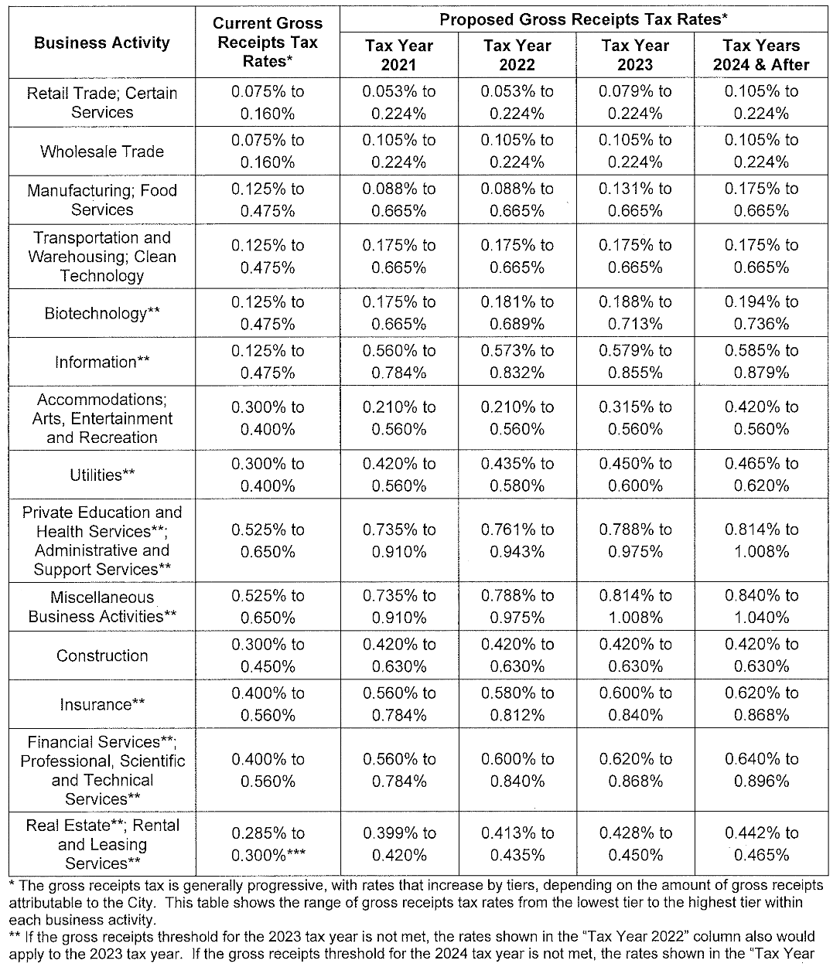
Modified Gross Receipts Tax Rates Based on Business Activity

Slide 9
Annual Business Registration Fee Changes
Businesses with Gross Receipts of less than $1mm
RG Fee reduction (approximately 50%) depending on Business Activity
Businesses with Gross Receipts between $1mm-$1.5mm
RG Fee shall be $230 or $245 depending on the Businesses Activity
Businesses with Gross Receipts between $1.501mm-$2.0mm
RG Fee shall be $435 or $460 depending on the Businesses Activity*
*Certain Services, Retail Trade, Wholesale Trade
**Increase is Effective 2021-2022

Slide 10
Annual Business Registration Fee Breakdown – General Fee
Pre July 1, 2021
Post July 1, 2021*
San Francisco Gross Receipts for the Immediately Preceding Tax Year | Annual Registration Fee
$0 to $100,000 | $90
$100,001 to $250,000 | $150
$250,001 to $500,000 | $250
$500,001 to $750,000 | $500
$750,001 to $1,000,000 | $700
$1,000,001 to $2,500,000 | $300
$2,500,001 to $7,500,000 | $500
$7,500,001 to $15,000,000 | $1,500
$15,000,001 to $25,000,000 | $5,000
$25,000,001 to $50,000,000 | $12,500
$50,000,001 to $100,000,000 | $22,500
$100,000,001 to $200,000,000 | $30,000
$200,000,001 and over | $35,000
San Francisco Gross Receipts for the Immediately Preceding Tax Year | Annual Registration Fee
$0 to $100,000 | $52
$100,001 to $250,000 | $86
$250,001 to $500,000 | $144
$500,001 to $750,000 | $288
$750,001 to $1,000,000 | $403
$1,000,001 to $1,500,000 | $575
$1,500,001 to $2,000,000 | $805
$2,000,001 to $2,500,000 | $345
$2,500,001 to $7,500,000 | $575
$7,500,001 to $15,000,000 | $1,725
$15,000,001 to $25,000,000 | $5,751
$25,000,001 to $50,000,000 | $14,379
$50,000,001 to $100,000,000 | $25,882
$100,000,001 to $200,000,000 | $34,510
$200,000,001 and over | $40,261
*Shall be adjusted annually according to CPI

Slide 11
Annual Business Registration Fee Breakdown – Retail, Wholesale Trade, and Certain Services
Pre July 1, 2021
Post July 1, 2021*
San Francisco Gross Receipts for the Immediately Preceding Tax Year | Annual Registration Fee
$0 to $100,000 | $75
$100,001 to $250,000 | $125
$250,001 to $500,000 | $200
$500,001 to $750,000 | $400
$750,001 to $1,000,000 | $600
$1,000,001 to $2,500,000 | $200
$2,500,001 to $7,500,000 | $400
$7,500,001 to $15,000,000 | $1,125
$15,000,001 to $25,000,000 | $3,750
$25,000,001 to $50,000,000 | $7,500
$50,000,001 to $100,000,000 | $15,000
$100,000,001 to $200,000,000 | $20,000
$200,000,001 and over | $30,000
San Francisco Gross Receipts for the Immediately Preceding Tax Year | Annual Registration Fee
$0 to $100,000 | $43
$100,001 to $250,000 | $72
$250,001 to $500,000 | $115
$500,001 to $750,000 | $230
$750,001 to $1,000,000 | $345
$1,000,001 to $1,500,000 | $475
$1,500,001 to $2,000,000 | $665
$2,000,001 to $2,500,000 | $230
$2,500,001 to $7,500,000 | $460
$7,500,001 to $15,000,000 | $1,294
$15,000,001 to $25,000,000 | $4,313
$25,000,001 to $50,000,000 | $8,627
$50,000,001 to $100,000,000 | $17,255
$100,000,001 to $200,000,000 | $23,006
$200,000,001 and over | $34,510
*Shall be adjusted annually according to CPI

Slide 12
Administrative Office – Post Prop F Process Flow
AOT – 3 Elements (Required)
Does the company meet all 3 elements?
Gross Receipts Analysis (refer to slide 5)
No
$1bn Gross Receipts
Yes
AOT Applied at Annual Tax Rate
1,000 US Employees
HAOT (HGR) Applied @ 1.5% of Payroll
50%+ Employees in SF are admin/mgmt

Slide 13
Administrative Office Tax Rate
(1) 2021 and 2022 AOT increases may be delayed by one year if they do not exceed 90% and 95% of the total GR receipts to the City for the 2019 taxable year

Slide 14
Revision of Quarterly Payments of GR and AOT
Adjust the required quarterly payments of GR taxes and Admin Office Taxes to the lesser of:
(1) 25% of the GR tax liability (or admin office liability) shown on the business’s prior year filing; and either
(2a) 25% of the GR tax liability as determined by applying the applicable GR tax rate and small business exemption for the current tax year to the taxable GR shown on the business’s return for the preceding tax year; or
(2b) 25% of the admin office tax liability as determined by applying the applicable admin office tax rate for the current year to the total payroll expense attributable to the City shown on the business’s return for the preceding tax year*
*Only applies if business was subject to the admin office tax liability in the preceding tax year)

